Slide 1
Implementation of machine learning algorithms in precision agriculture using soil data
Author: Crisan Dragos Coordinator: Adriana Mihaela Coroiu

Slide 2
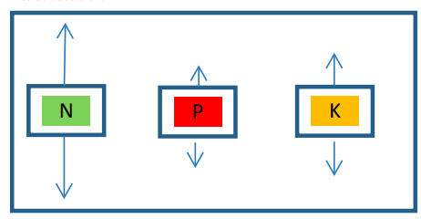
Motivation
Major changes in the climate
Farmers rely on intuition and knowledge from the past for their decisions
The intuition of farmers is affected by the major changes
Desertification of land due to climate reasons or improper practices
Discussions with teacher Nicu Sima (USAMV) in regards to the needs of the market and the most influential factors

Slide 3
Objective
Providing workers in the field with useful information
The creation of machine learning algorithms to make predictions and provide such information
Creation of multiple such algorithms for comparison and exploration of new possibilities purposes
Encouraging the creation of more comprehensive datasets
Paving a path for future developments

Slide 4
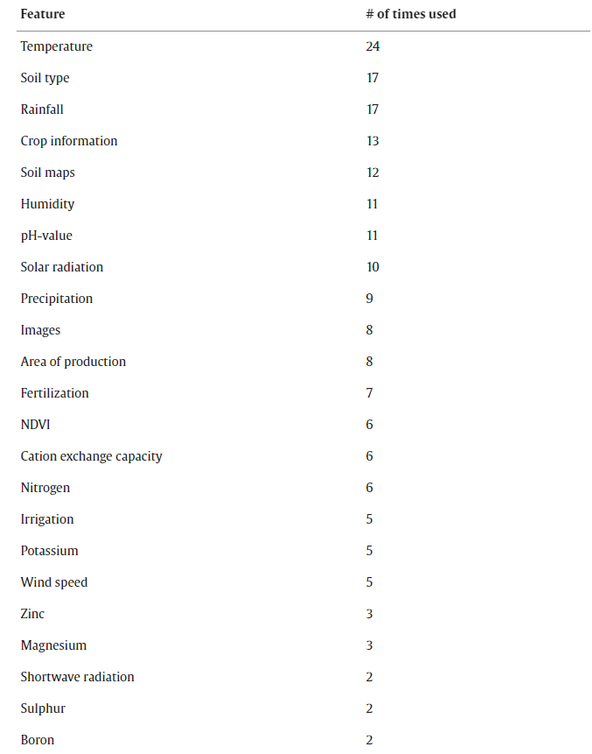
State of the Art
Similar papers focus on the climate data
There are papers that also include soil data but focus on certain aspects of it, like a study that focuses on Nitrogen
Accuracies of these studies vary, with results ranging from 75% to 96%
In our approach, we focused on the introduction of comprehensive soil data to our model
The focus is on the 3 most important macronutrients in the soil

Slide 5
Datasets
Since there are only a few papers utilizing soil data, the datasets that include this information are even scarcer
We based our work on a dataset that had his data collected in India, between 2018 and 2019 containing multiple crops from multiple areas
The dataset is split into four parts, containing information about: crop production, crop prices, soil data and water usage
We excluded the crop price set
We merged and encoded the rest

Slide 6
Machine Learning Algorithms
Extreme Gradient Boosting on crop yield prediction
Most suited for the nature of our dataset
High performance on tabular data
Reached accuracy of 99.78%
Convolutional Neural Networks on crop yield prediction
Reached accuracy of 95% but had a higher error rate
Provided comparative benchmark
Performs better for datasets with more complex relations between the data
Might perform better for future datasets

Slide 7
Machine learning algorithms
Fully Convolutional Neural Networks on N, P and K levels recommendations
Provides a completely new way of utilizing the data
Explores other information we can predict
Due to the complexity of having three predictions the accuracy was affected
Reached accuracy of 85%
Introduces new directions the project can take

Slide 8
Application Building
Database created using DataGrid IDE with sqlite
Used for the login and register
Used for fetching data for the dropdowns to avoid hardcoding
Server developed using Python and FastAPI for handling data processing and HTTP requests
Required the import of encoders and scalers to enable the processing of input from frontend
Frontend implemented with react with user-friendly interface
The frontend forms are designed with foolproof inputs

Slide 9
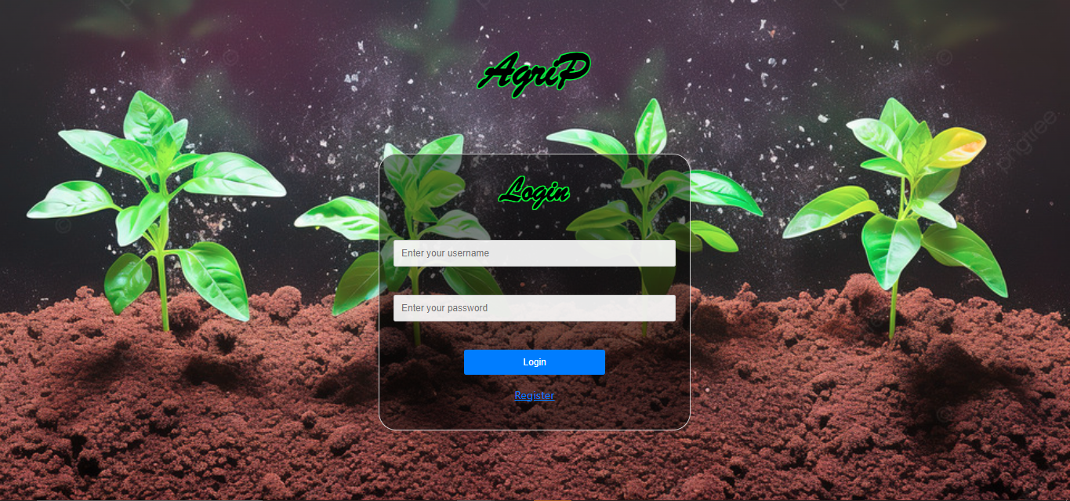
Frontend

Slide 10
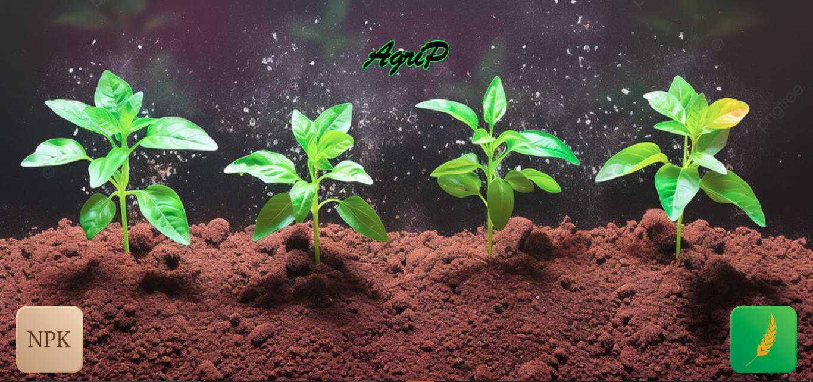
Frontend

Slide 11
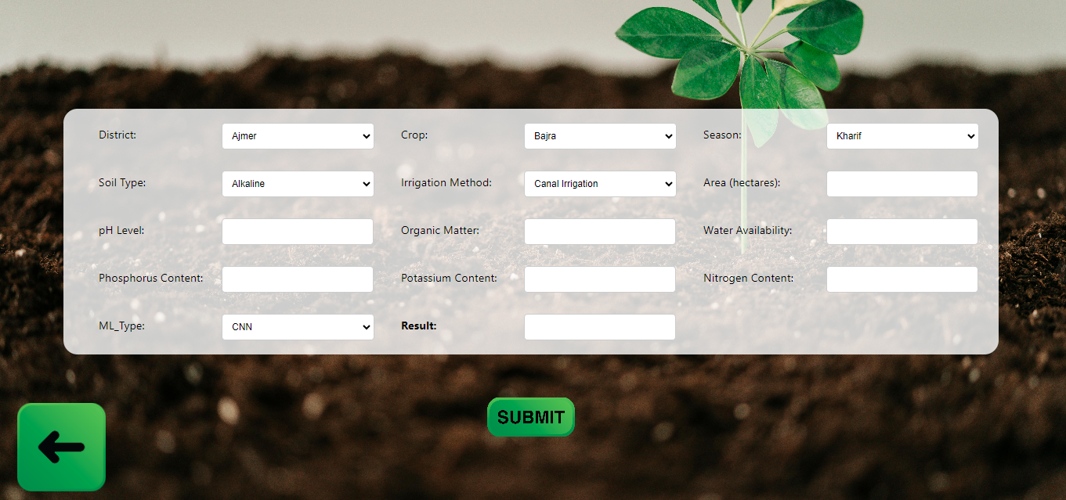
Frontend

Slide 12
Future Developments
The FCNN algorithm opens a new path to what we can predict
In case more information about fertilizers used is provided, it could turn into recommending quantity of fertilizer to be used
Two issues are presented in this scenario:
The accuracy continues to lower
The result is vague
Solutions:
The reason behind the CNN model
Introduction of temporal data in addition to more comprehensive datasets
The introduction of climate data

Slide 13
Conclusions
Our study showcases the accuracy soil information and irrigation can produce in predictive models
XGB model provided the best results
CNN model had close results to the XGB model, coming near in accuracy
FCNN model showed new possibilities
There are a lot of possible future developments in the field with a lot of potential
We encourage the development of more comprehensive datasets

Slide 14
Thank you for your attention

